Slide 1
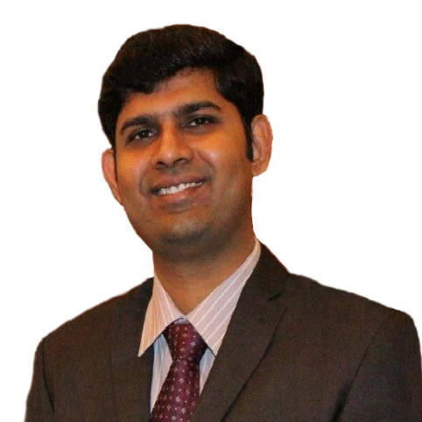
Profile of Vishnu varthanan Moorthy, Program Manager– Quality Assurance
Role: Strategic Partner for Group Quality Center of Excellence & Strategic lead - India Quality
Name
Vishnu Varthanan Moorthy
Professional experience
Vishnu varthanan Moorthy has around 17 years of overall experience in IT & Quality Assurance. He has expertise in agile, CMMI and Lead Auditor for multiple Standards. He is certified in Prince 2, ITIL frameworks.
Vishnu is the Strategic Partner for Group Quality Center of Excellence & Strategic lead India Quality in Capgemini. He is actively involved in bringing technology aligned quality practices. He manages the strategic quality Initiatives planning and monitoring in Quality Assurance Practices. involved with process set-up and pragmatic process implementation along with driving several value-adds using CMMI, ISO and Agile etc.
Vishnu has actively participated in several forums and conferences. He has written books on Software Quality Assurance and CMMI High Maturity achievements. In the past , vishnu has been a consultant to various organizations to improve their quality systems to enable business results achievement.
Level
Program Manager
Nationality
Indian
Education and Competences
Competencies
Core Team Member of CMMI 2.0 release
Software Quality Assurance, Software Engineering Process Group
Process Consultancy for end clients and Capgemini Onshore locations
Process setup and institutionalization in accordance with ITIL, COBIT, etc.
Certified Appraisal team Member (ATM) for CMM, CMMI-DEV v1.3 and CMMI-SVC Model
Certified Six Sigma Black Belt and LEAN methodology
Certified ISO 20000 Lead auditor
Certified ISO 9001 Lead Auditor
Implementation Expertise in ISO27001(Information Security)
Certified Scrum Master
Education
Master of Business Administration
Bachelor of Engineering

