Slide 1
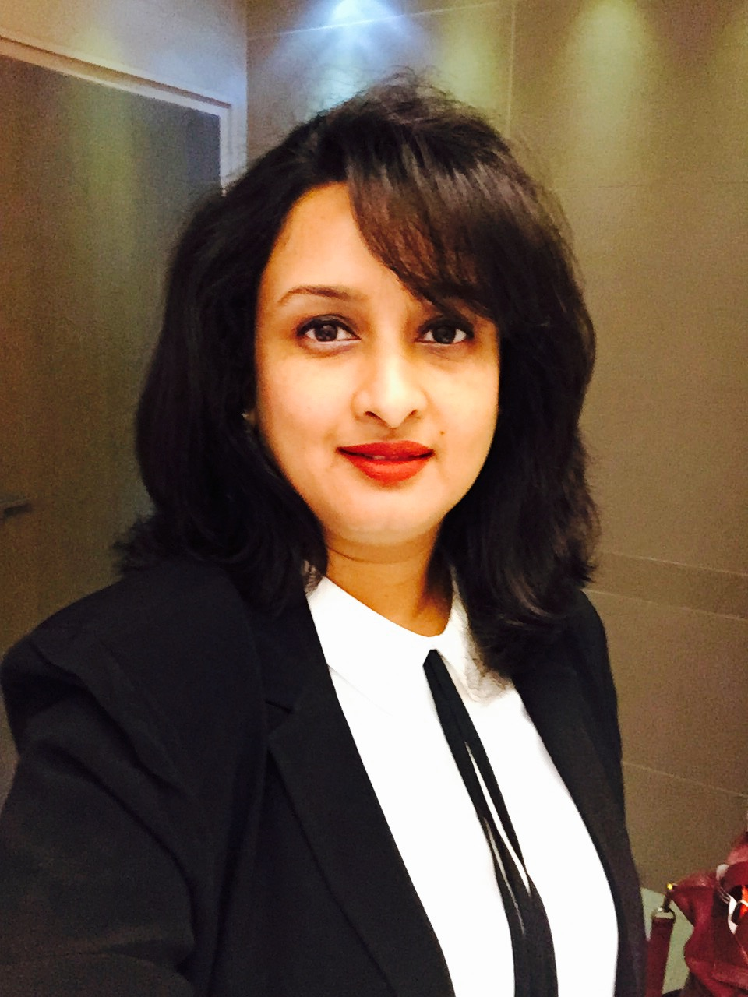
Sonali Khopkar
Senior Director - Global Quality
Capgemini
Profile
Sonali is a seasoned IT professional with proven expertise in managing various facets of the IT Services. With ability to plan and execute a wide range of strategies, she have proven experience in Strategic Planning, Delivery Assurance, Risk Management, Process Quality Management & leading senior teams across geographies.
In her career span of 20 plus years with the IT Industry and lateral movements across functions, she has hands-on experience in IT Delivery, Quality, setting up and managing the entire business unit, encompassing Strategizing, Planning; Budgeting; People Management, Recruitment & Training and contributing to the international forums along with consulting expertise.
She is a co-editor for ISO 20000 standards and represents India at the ISO international forum

